Slide 1
THE HUMAN

Slide 2
THE HUMAN
The ultimate purpose of an interactive program is to improve the efficiency and effectiveness of a user's performance;
  where performance is a measure of the time and effort expended to complete tasks.

Slide 3
THE HUMAN
HCI comprises of three aspects: the Human, the Computer & the actual task they interact on.
The Human is the most important aspect & the most complex.

Slide 4
THE HUMAN
Information i/o …
  visual, auditory, Touch, movement
Information stored in memory
  sensory, short-term, long-term
Information processed and applied
  reasoning, problem solving, skill, error
Emotion influences human capabilities
Each person is different

Slide 5
The HUMAN
User performance may be described in terms of a number of determinants, including;
  Visual Channel
  Auditory Channel
  Touch
  Memory

Slide 6
Input-Output Channel
Visual-Channel
  Human vision is a highly complex activity.
  It is the primary source of information about the outside world.

Slide 7
Input-Output Channel
Visual perception can be divided into two stages:
  The physical reception of the stimulus from the outside world.
  The processing and interpretation of that stimulus

Slide 8
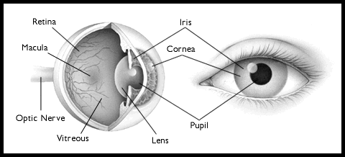
Input-Output Channel

Slide 9
Input-Output Channel
The eye is basically a mechanism for receiving light and transforming it into electrical energy.
The receptors in the eye transform it into electrical signals, which are passed on to the brain

Slide 10
Input-Output Channel
The eye has a lot of components.
  The cornea and lens at the front of the eye focus the light into a sharp image on the back of the eye, the retina.
  The retina is made up of rods and cones.

Slide 11
Input-Output Channel
Rods are highly sensitive to light and allow us to see under low levels of illumination (Light) .
There are approximately 120 million rods per eye which are mainly situated towards the edges of the retina.

Slide 12
Input-Output Channel
Cones are less sensitive to light than rods and can tolerate more light.
These cones which number about 6 million.
Cones are mainly concentrated on the fovea, a small area of the retina on which images are formed.

Slide 13
Input-Output Channel
Visual perception
  The information that is gathered by the eye must be filtered and passed to the brain, which in turn generates coherent (logical / sound) images.

Slide 14
Input-Output Channel
Reflected light from an object forms an inverted image on the retina of the eye.
The size of that image is specified as a visual angle.
The visual angle is affected by both the size of the object and its distance from the eye.

Slide 15
Input-Output Channel
If two objects are at the same distance, the larger one will have the larger visual angle.
However, our perception of an object's size remains the same even if its visual angle changes.

Slide 16
Input-Output Channel
Color is usually regarded as being made up of three components: hue, intensity, and saturation.
  Hue is determined by the spectral wavelength of the light entering the eye.
    An average person can distinguish 150 different hues.
  Intensity is the brightness of the color.
  Saturation is the amount of whiteness in the color.

Slide 17
Input-Output Channel
The movement of the image on the retina which occurs as we move around and as the object which we see moves.
Although the retinal image is moving, the image that we perceive is stable.

Slide 18
Input-Output Channel
Reading
  When we read a word, a visual pattern is perceived which is then decoded with reference to an internal representation of the language.
  This is then analyzed syntactically and semantically in the context of a phrase or sentence.

Slide 19
Input-Output Channel
Hearing
  The auditory system has a tremendous capacity for conveying information.
  The biggest advantage of the ear is due to the fact that it can process sounds without concentrating on the source which produces it.

Slide 20
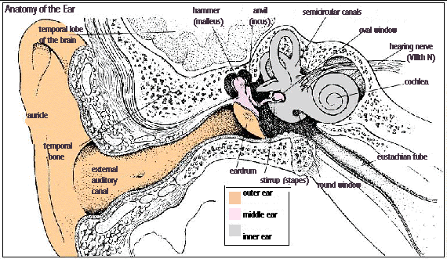
Input-Output Channel

Slide 21
Input-Output Channel
Hearing is caused by the vibrations of air or sound waves.
The ear receives these vibrations and transmits them, through various stages, to the auditory nerves.

Slide 22
Input-Output Channel
Processing sound
  Sound characteristics:
    Pitch is defined as the frequency of sound.
    Loudness is the amplitude of the sound wave.
    Timbre is the “Type" or Quality of the sound.
      Different instruments may vary in timbre despite having the same pitch and loudness.
The human ear can hear frequencies which from about 20 Hz. to 15 kHz.

Slide 23
Input-Output Channel
Touch
  The apparatus of touch differs from that of sight and hearing;
    as it is not localized.

Slide 24
Input-Output Channel
The skin contains three types of sensory receptors:
  Thermo-receptors which respond to heat and cold.
  Nociceptors which respond to intense pressure, heat and pain.
  Mechanoreceptors which respond to pressure.

Slide 25
Input-Output Channel
There are two kinds of mechanoreceptors
  Rapidly adapting mechanoreceptors
    They stop responding if continuous pressure is applied
  Slowly adapting mechanoreceptors
    respond to continuously applied pressure

Slide 26
Human Memory
There are generally three types of memory:
  sensory memory
  short-term memory
  long-term memory.

Slide 27
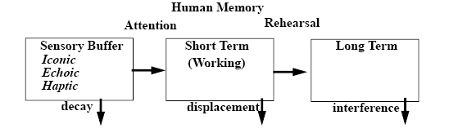
Human Memory

Slide 28
Human Memory
Sensory memory
  The sensory memories act as buffers for stimuli received through the senses.
  A sensory memory exists for each sensory channel:
    iconic memory for visual stimuli,
    echoic memory for auditory stimuli
    haptic memory for touch.

Slide 29
Human Memory
Information is passed from sensory memory into short-term memory by attention, thereby filtering the stimuli to only those which are of interest at a given time.

Slide 30
Human Memory
Short-term memory
  Short-term memory acts as a scratch-pad for temporary recall of the information under process.
  For instance, in order to understand this sentence you need to hold in your mind the beginning of the sentence you read the rest.

Slide 31
Human Memory
Short term memory decays (perish) rapidly (200 ms.) and also has a limited capacity
Chunking of information can lead to an increase in the short term memory capacity.
  That is the reason why a hyphenated phone number is easier to remember than a single long number.

Slide 32
Human Memory
Long-term memory
  Long-term memory is intended for storage of information over a long time.
  Information from the working memory is transferred to it after a few seconds.
  Unlike in working memory, there is little decay.

Slide 33
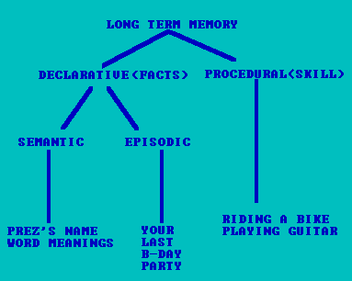
Human Memory
Long-term memory structure

Slide 34
Human Memory
There are two types of long-term memory:
  episodic memory
  semantic memory.

Slide 35
Human Memory
Episodic memory represents our memory of events and experiences in a serial form.
It is from this memory that we can reconstruct the actual events that took place at a given point in our lives.

Slide 36
Human Memory
Semantic memory, on the other end, is a structured record of facts, concepts and skills that we have acquired.

Slide 37
Human Memory
Long-term memory processes
  There are three main activities related to long term memory:
    storage,
    deletion
    retrieval.

Slide 38
Human Memory
Storage
  Information from short-term memory is stored in long-term memory by rehearsal.
  The repeated exposure to a stimulus or the rehearsal of a piece of information transfers it into long-term memory.

Slide 39
Human Memory
Deletion
  Deletion is mainly caused by decay and interference.
  Emotional factors also affect long-term memory.

Slide 40
Human Memory
Retrieval
  There are two types of information retrieval:
    Recall
      In recall, the information is reproduced from memory
    Recognition.
      In recognition the presentation of the information provides the knowledge that the information has been seen before

Slide 41
Thanks

